Slide 1

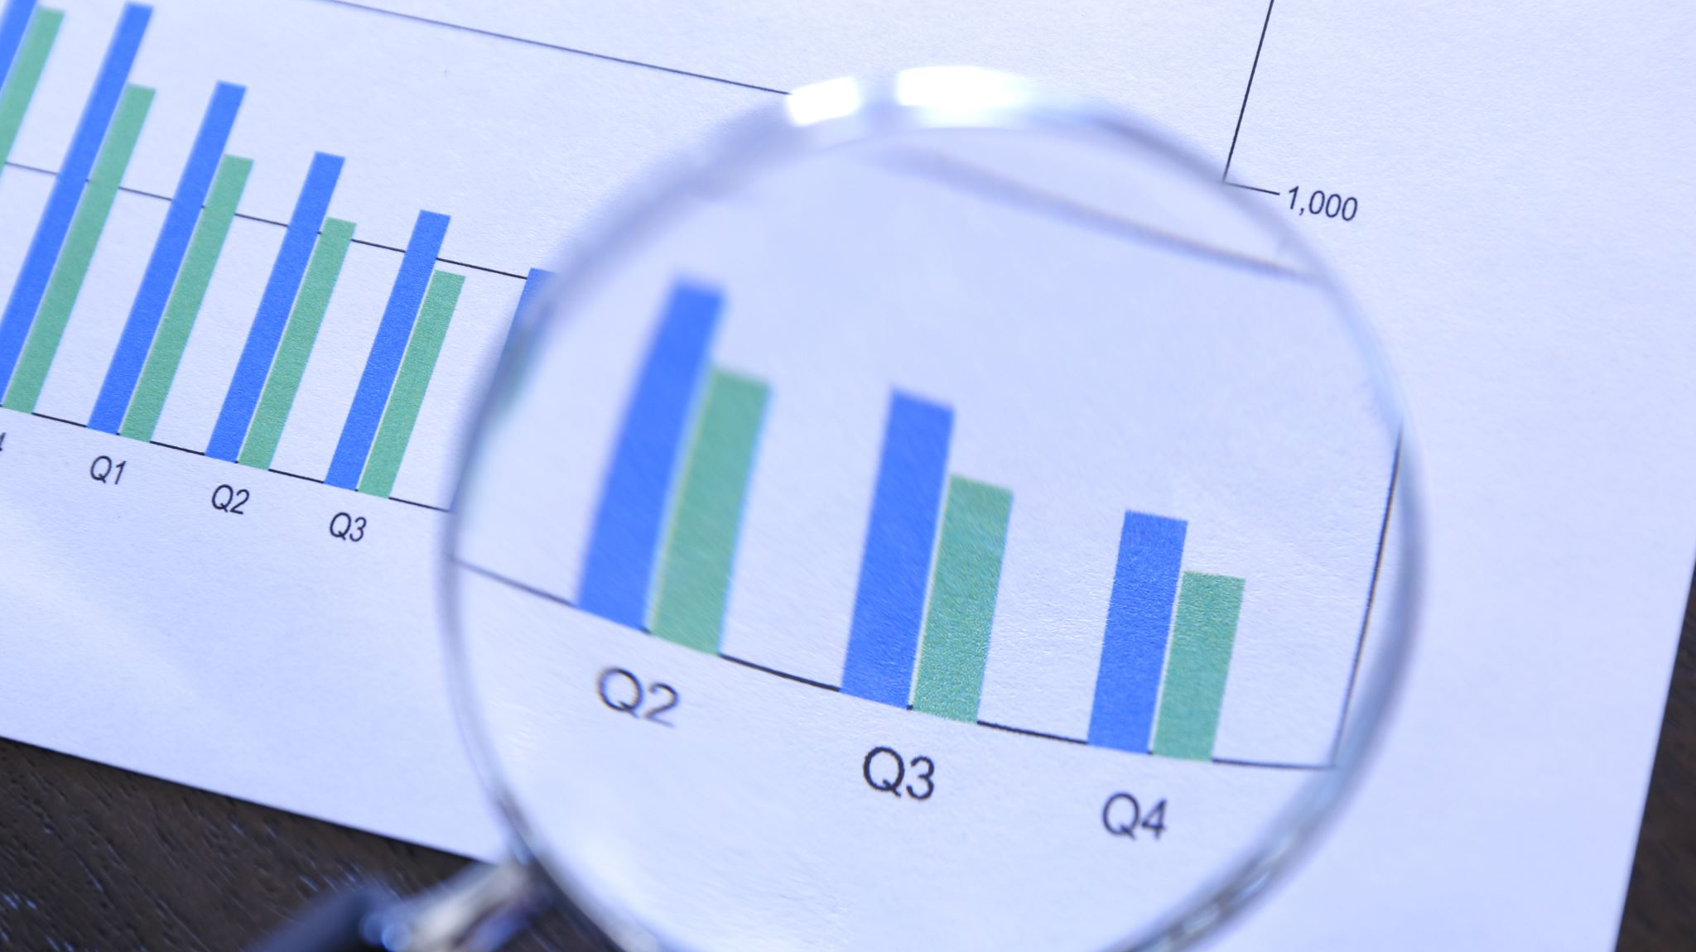
BlackRock Investment Analysis
Weekly status report 6

Slide 2
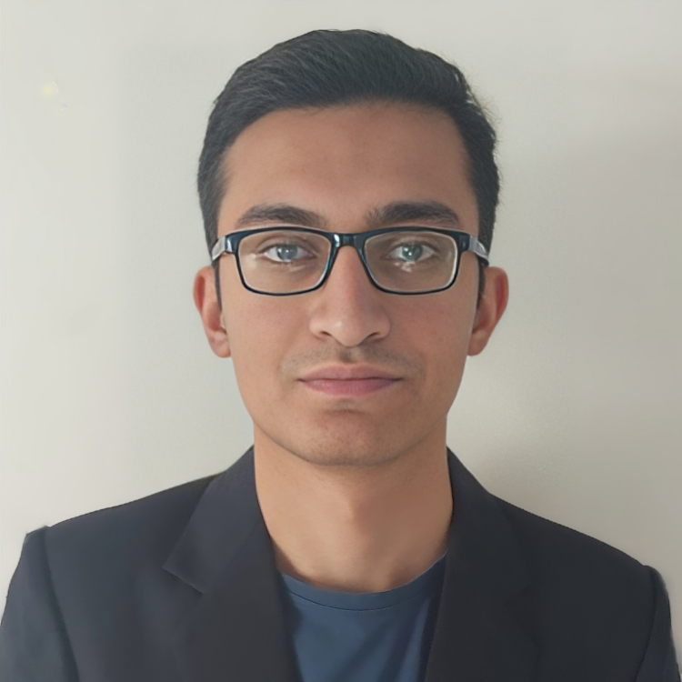
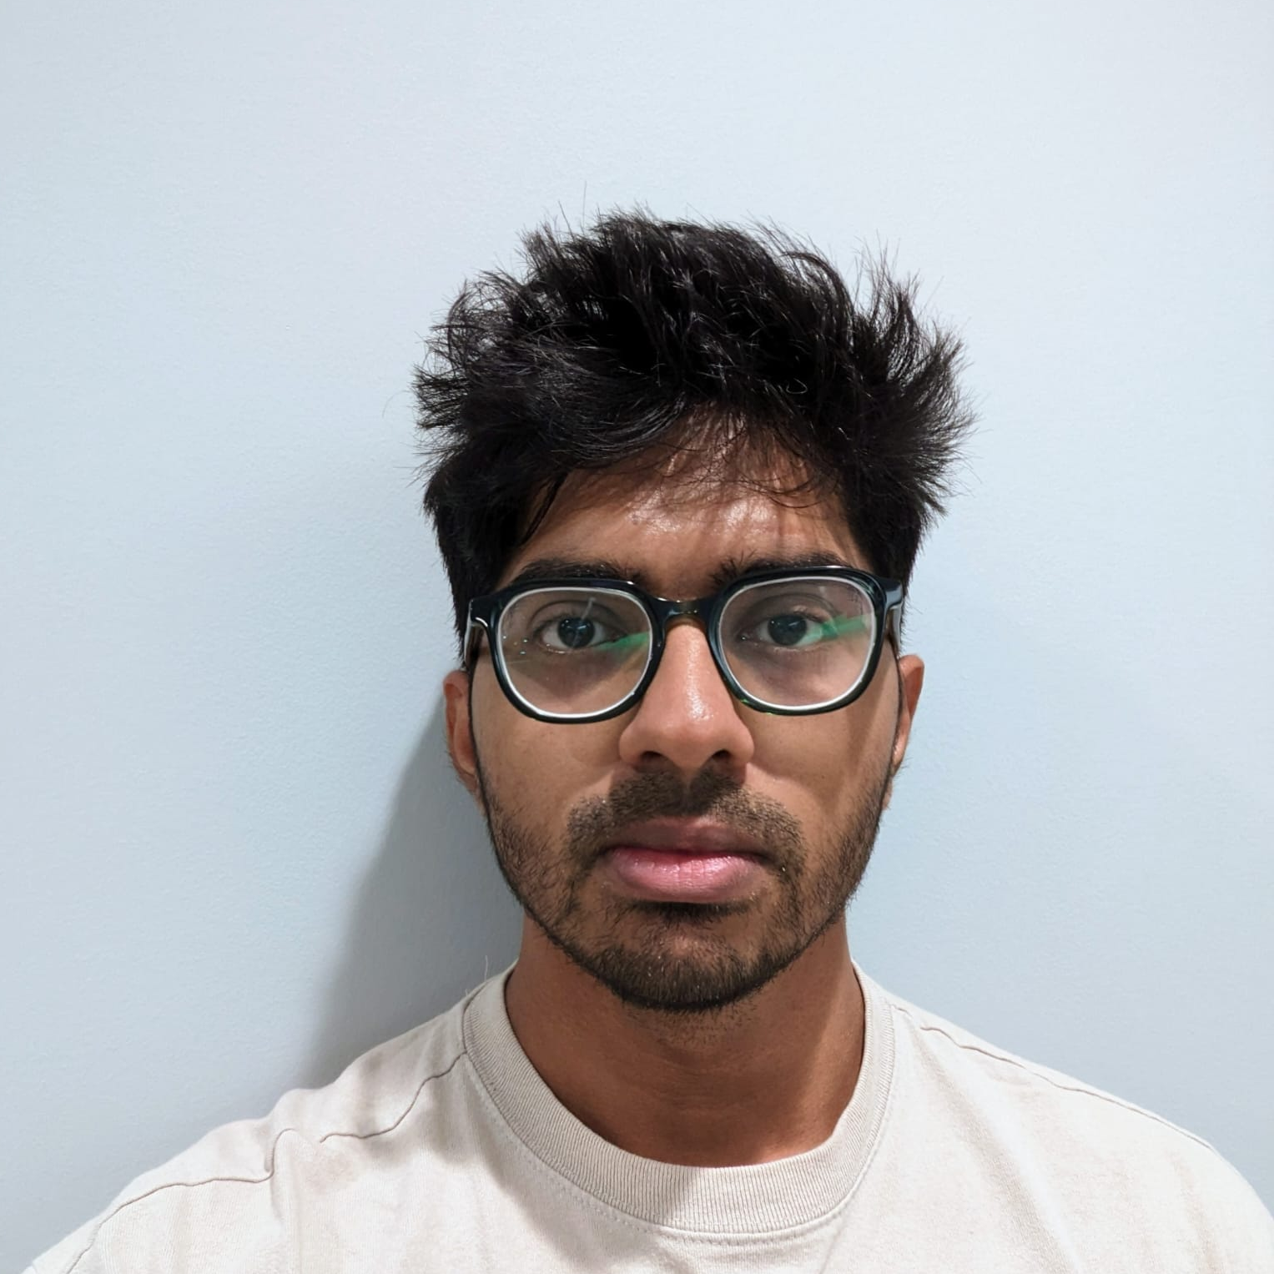
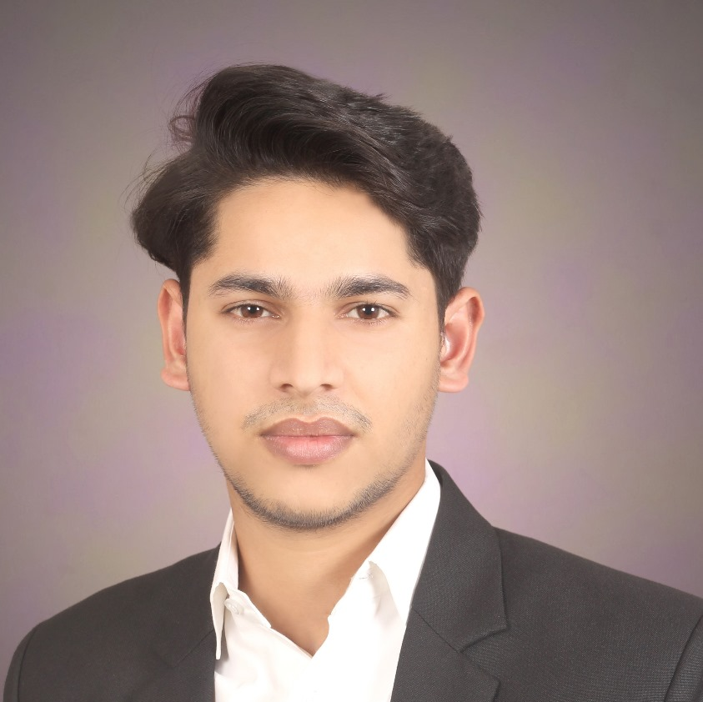
Team Members
Aryan Radadiya
Developer
Joyson Gonsalves
Team Lead
Sumit Kumar Pandey
Data Analyst

Slide 3
Date of Report: 20th February 2024
Date of Last Report: 13th February 2024
Prepared By: Group 7
Project Status: On Track

Slide 4

Activities Since Last Report
Issues or Challenges encountered this week:
Researching on cluster algorithm and implementing it.
What was done to overcome them:
We are searching for references and understanding how the machine learning model works.
We solved the errors occurred during code.

Slide 5
Activities Since Last Report
Task completed this week:
Implemented the machine learning algorithm (Cluster Algorithm).
Share point site is up to date.

Slide 6

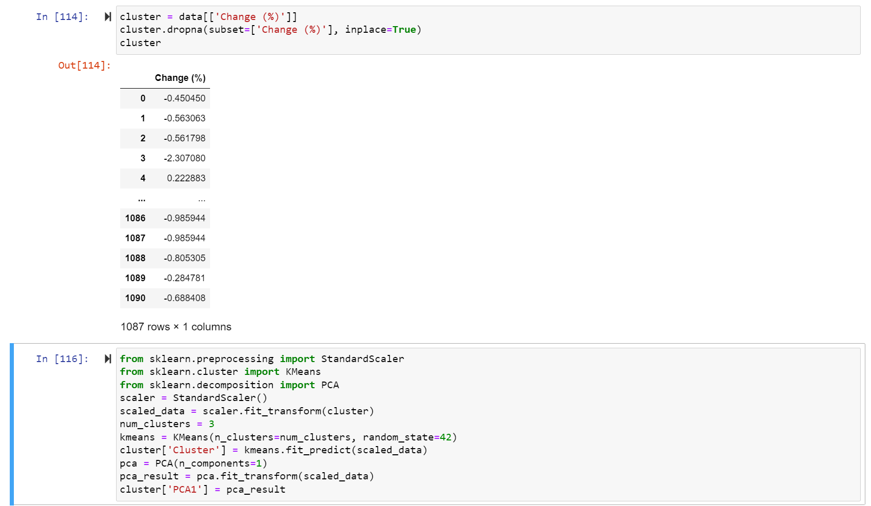
Screenshots of Activities

Slide 7
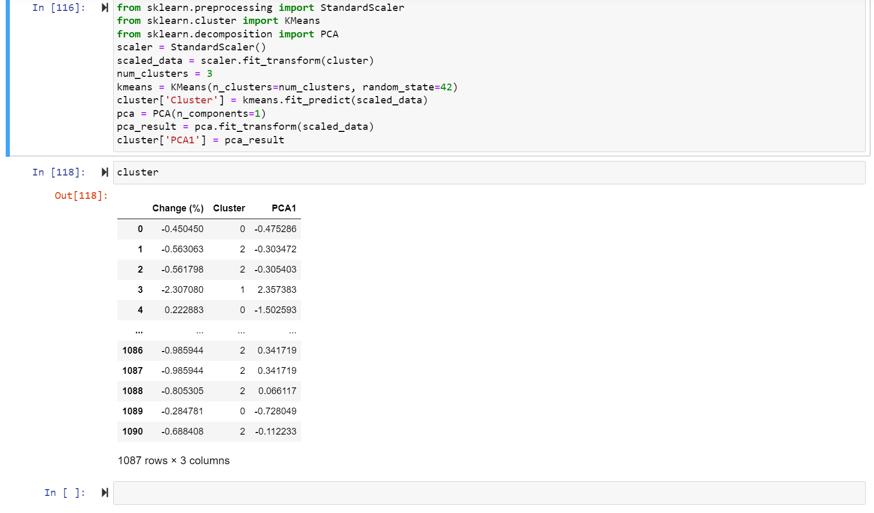
Screenshots of Activities

Slide 8



Communication
We had a phone conversation regarding the project progress and how we are going to proceed.

Slide 9

Activities to be completed before next week
Researching more on data.
Starting to design and implement visualization.

Slide 10

Thank You Any Questions?

